Slide 1
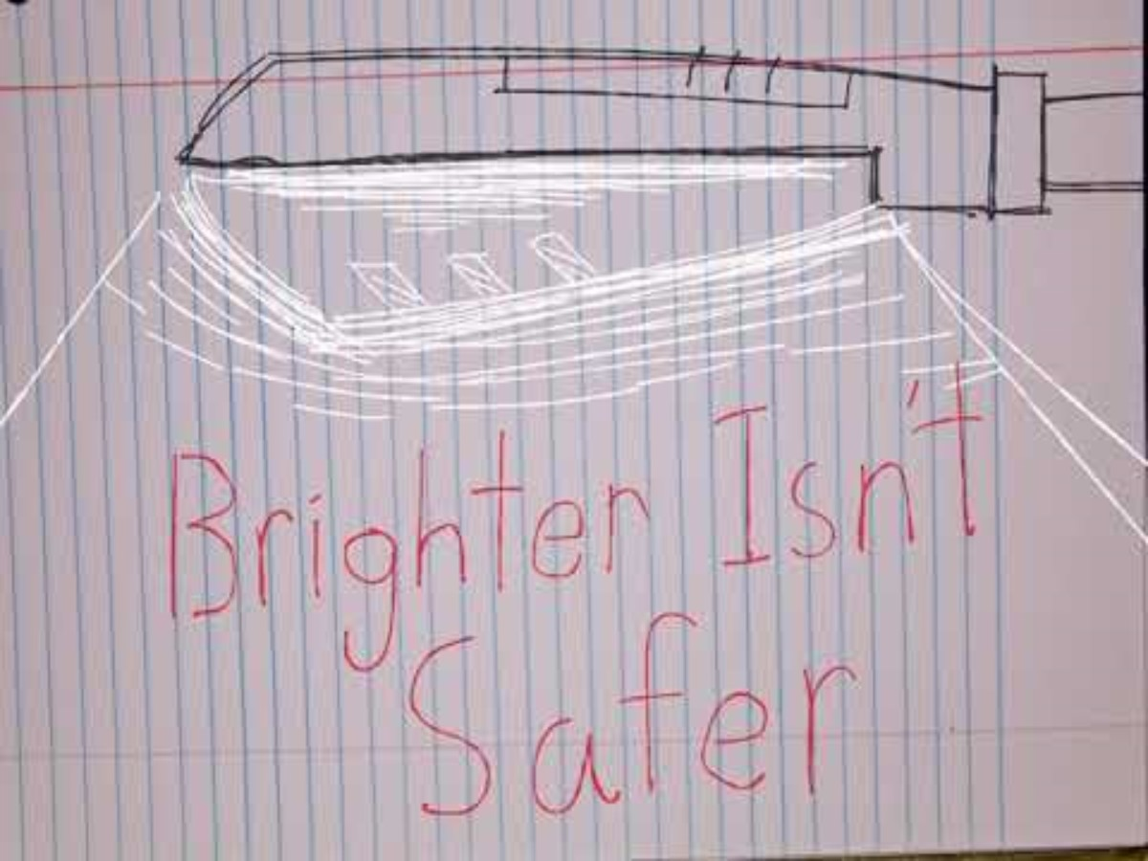

Slide 2
Made with Blender and Davinci Resolve
bibliography
Fuse, S., Yoshida, T., & Kobayashi, Y. (2024). Effects of artificial night lighting on a web-building spider species in urban green spaces. Acta Oecologica, 124, 104017. https://doi.org/10.1016/j.actao.2024.104017
Levin, E. (2010, May 4). Visibility, environmental, and astronomical issues associated with blue-rich white outdoor lighting. LightAware. https://lightaware.org/visibility-environm...
Staff. (n.d.). Outdoor lighting at night doesn’t do what you think it does to reduce crime and increase safety. DarkSky International. https://darksky.org/resources/what-is-ligh....
Fabian, S. T., Sondhi, Y., Allen, P. E., Theobald, J. C., & Lin, H.-T. (2024). Why flying insects gather at artificial light. Nature Communications, 15(1). https://doi.org/10.1038/s41467-024-44785-3
Kehoe, R., Sanders, D., & van Veen, F. J. (2022). Towards a mechanistic understanding of the effects of artificial light at night on insect populations and communities. Current Opinion in Insect Science, 53, 100950. https://doi.org/10.1016/j.cois.2022.100950
Owens, A., Cochard, P., Durrant, J., Perkin, E., & Seymoure, B. (2019). Light pollution is a driver of insect declines. SSRN Electronic Journal. https://doi.org/10.2139/ssrn.3378835
Halsch, C. A., Elphick, C. S., Bahlai, C. A., Forister, M. L., Wagner, D. L., Ware, J. L., & Grames, E. M. (2025b). Meta-synthesis reveals interconnections among apparent drivers of Insect Biodiversity Loss. BioScience. https://doi.org/10.1093/biosci/biaf034
Steinbach, Rebecca, Chloe Perkins, Lisa Tompson, Shane Johnson, Ben Armstrong, Judith Green, Chris Grundy, Paul Wilkinson, and Phil Edwards. “The Effect of Reduced Street Lighting on Road Casualties and Crime in England and Wales: Controlled Interrupted Time Series Analysis.” Journal of Epidemiology and Community Health 69, no. 11 (July 28, 2015): 1118–24. https://doi.org/10.1136/jech-2015-206012.

